Slide 1


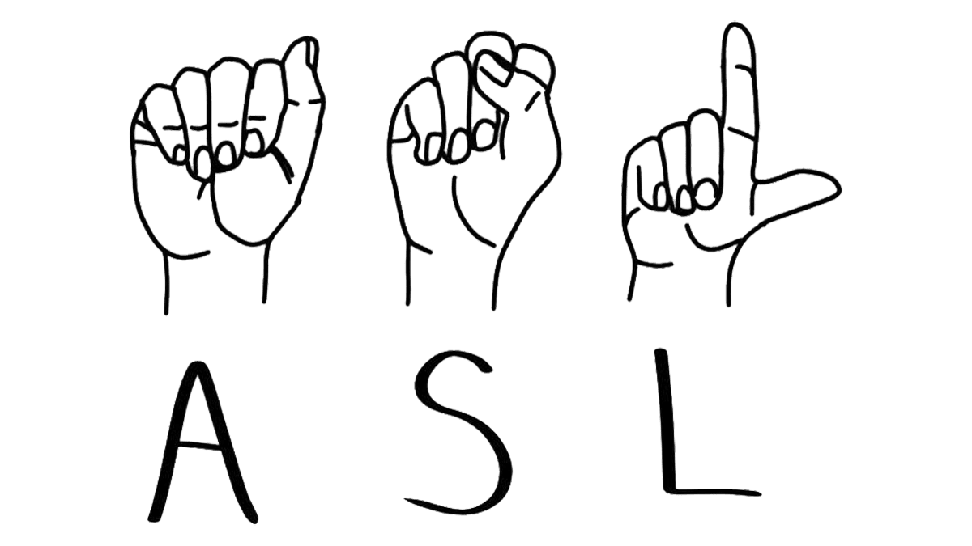
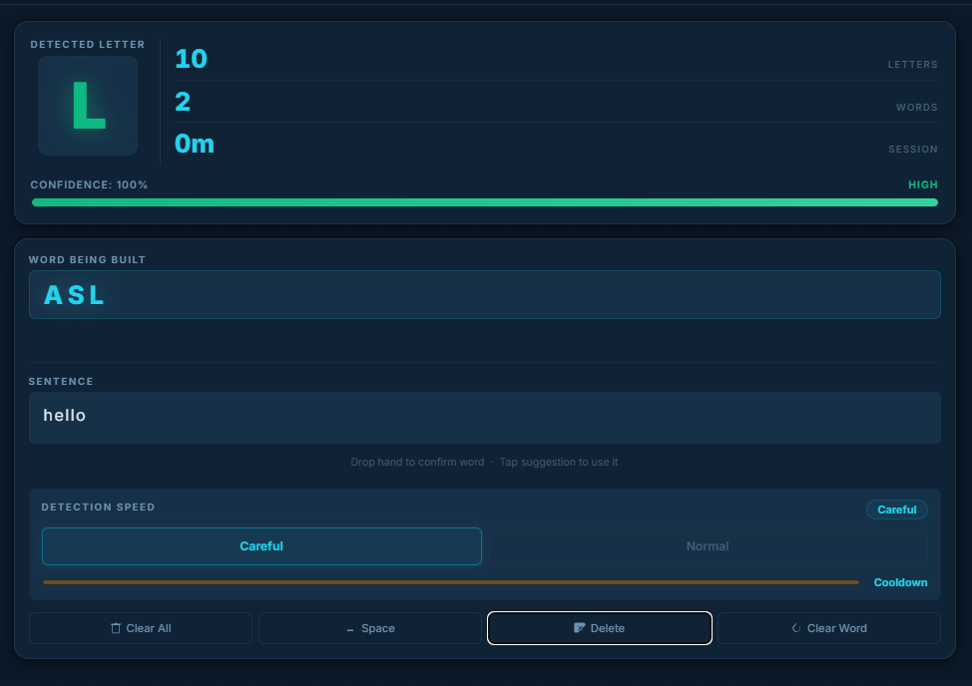
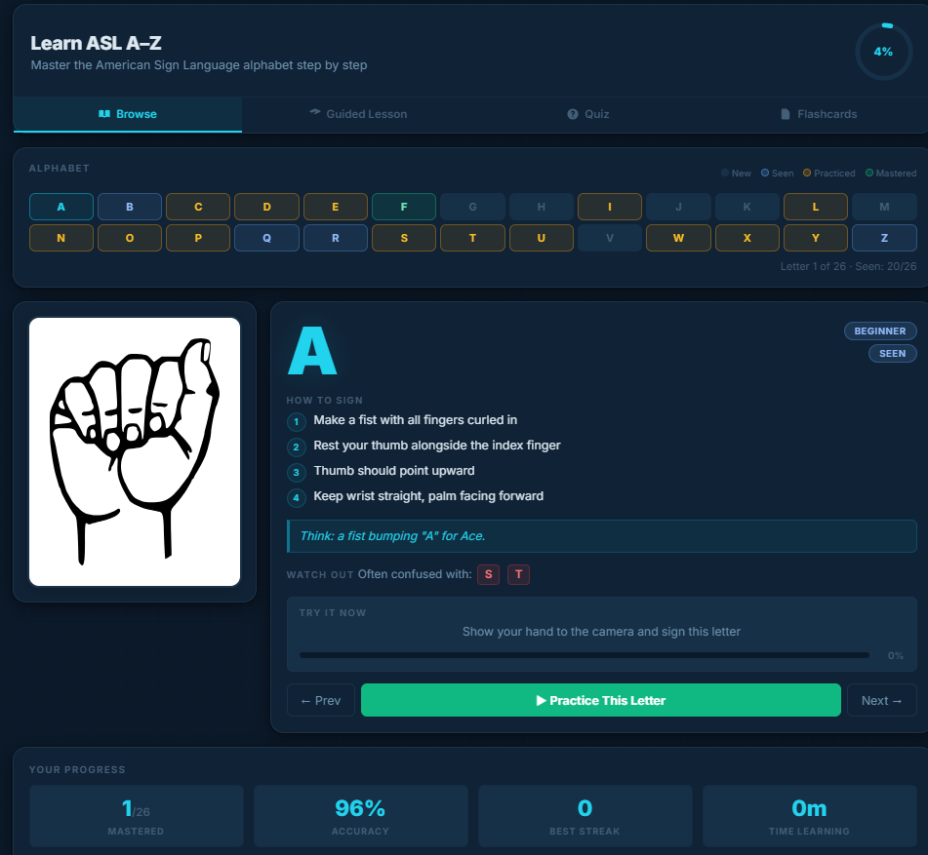
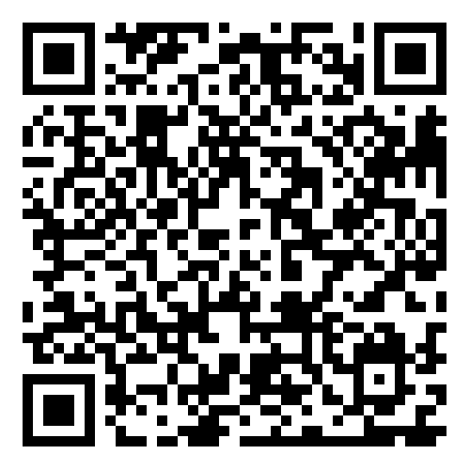
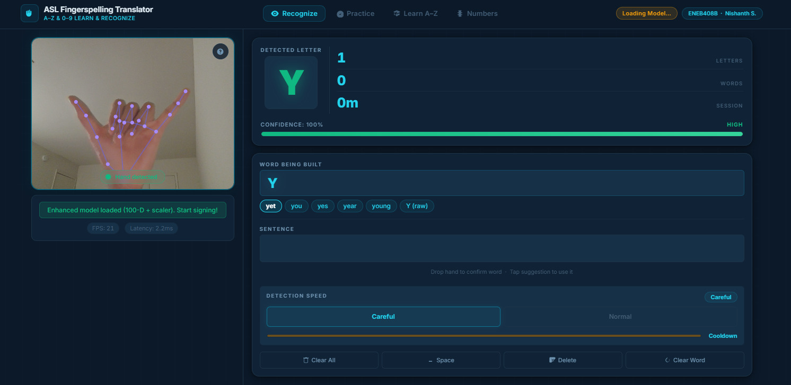
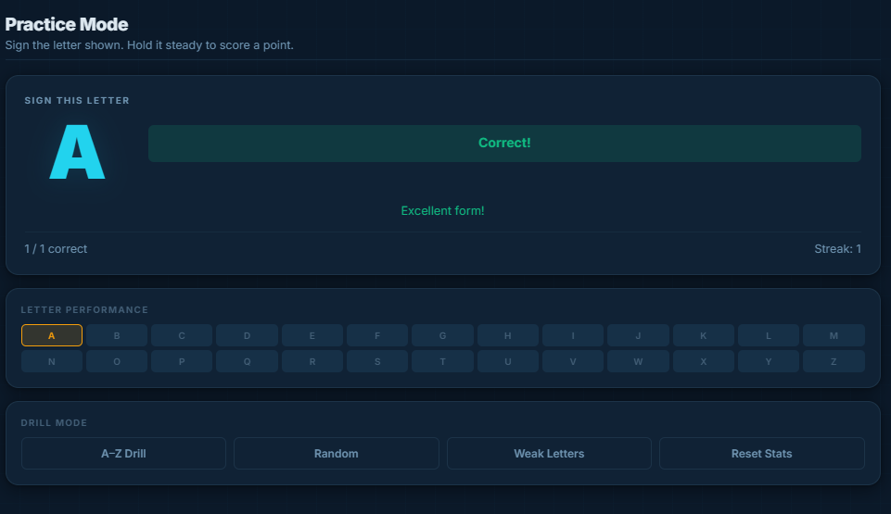
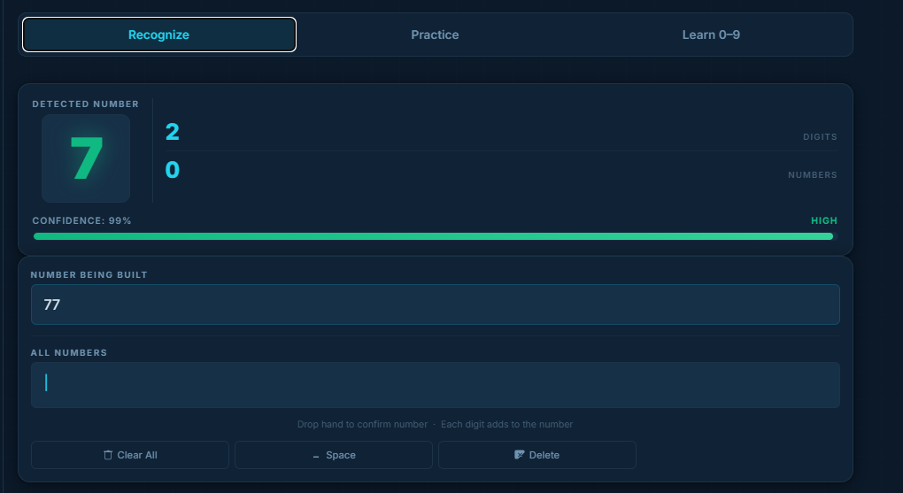
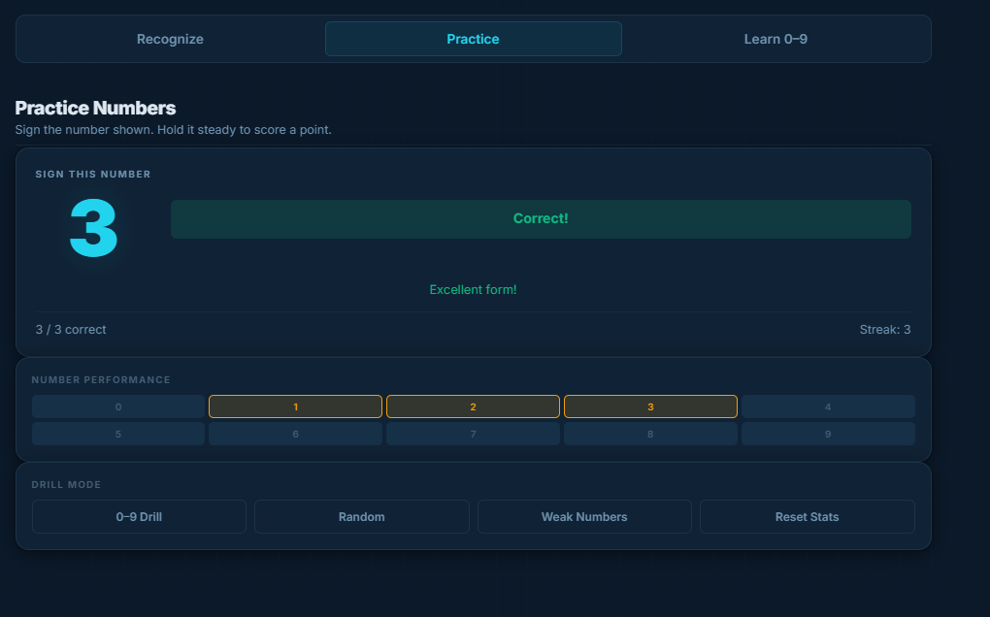
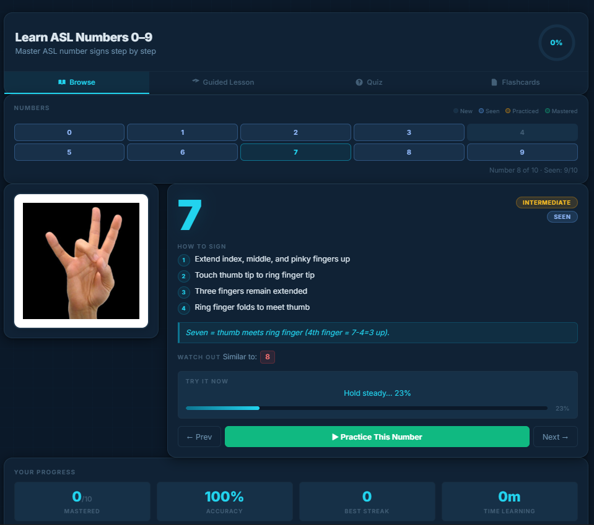
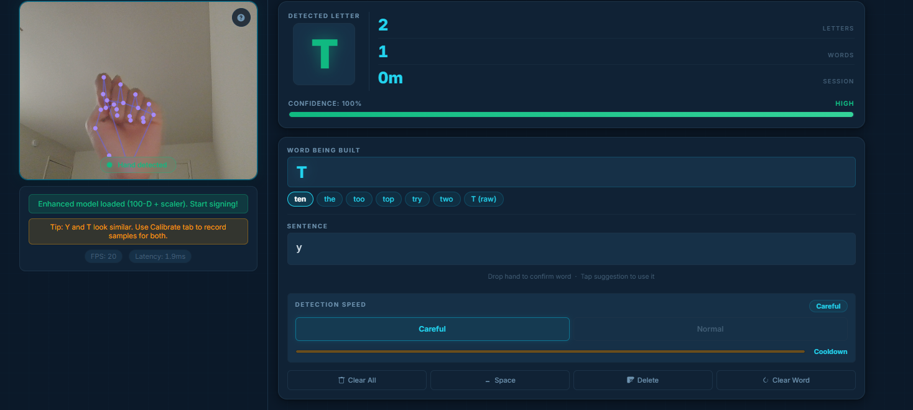
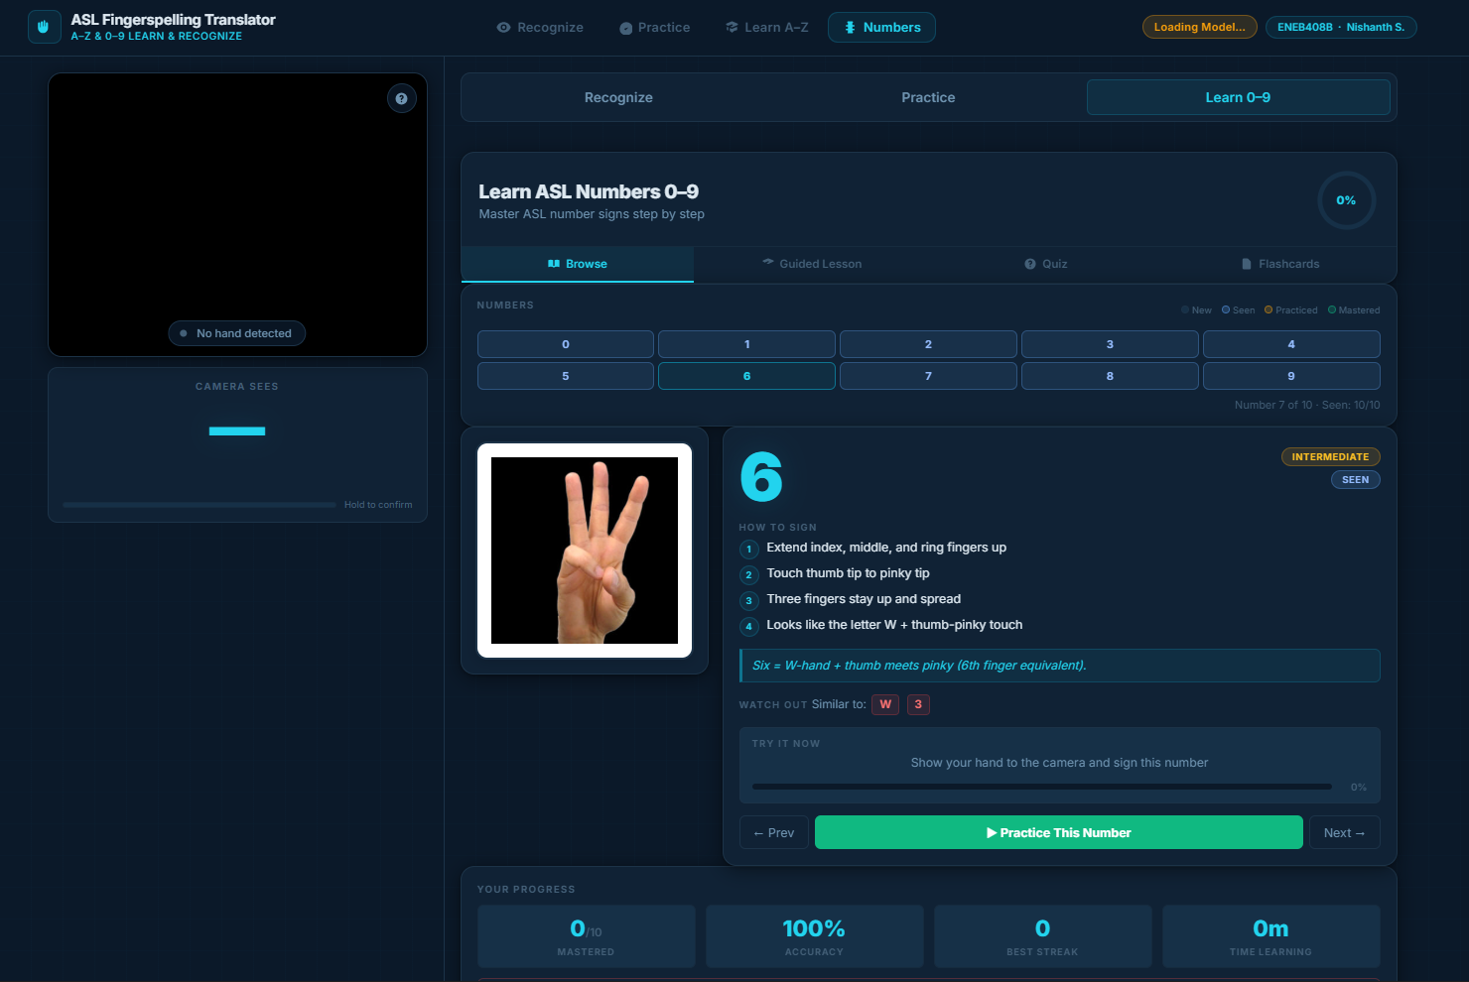
Real-Time ASL Alphabet to Text Translator and Trainer
Using MediaPipe Hand Tracking and TensorFlow.js Neural Networks
Nishanth S. | ENEB408B Capstone Design Lab II | University of Maryland | Spring 2026
BACKGROUND AND MOTIVATION
METHODOLOGY AND SYSTEM DESIGN
RESULTS AND ANALYSIS
The Technology
The Problem
• Over 500,000 people in the United States use American Sign Language as their primary language, but most hearing people don't understand it. This creates a real communication gap in everyday situations like classrooms, hospitals, and workplaces.
• Existing ASL translation tools are either expensive, require special hardware, or need a server connection. Most people who need a quick translation don't have access to these tools.
Why It Matters
• ASL fingerspelling is used to spell out names, technical terms, and words that don't have a dedicated sign. It accounts for roughly 35% of ASL communication in educational settings.
• A free, browser-based translator that works on any device with a webcam could make ASL communication more accessible to millions of people without any setup or cost.
Prior Work
• Previous approaches used Convolutional Neural Networks on raw images, requiring large models (50-200MB) and server-side processing with significant latency.
• Our approach uses hand landmark extraction (MediaPipe) to reduce the problem from image classification to a lightweight 100-feature vector classification, enabling real-time browser inference.
Technology Stack: HTML/CSS/JS • MediaPipe Hands • TensorFlow.js • No backend
The system runs entirely in the browser with zero server dependency. It uses a three-stage pipeline: hand detection, feature extraction, and neural network classification.
Stage 1: Hand Detection (MediaPipe)
• Google's MediaPipe Hands detects 21 3D landmarks on the hand in real time at 30+ FPS using WebGL acceleration
• Each landmark has x, y, z coordinates relative to the image frame
• Runs as a client-side WASM + WebGL module — no server needed
Stage 2: Feature Engineering (100-D Vector)
• Raw 63 landmarks are normalized relative to the wrist and scaled by hand size, making the features position- and size-independent
• 10 pairwise fingertip distances capture finger spread patterns
• 9 joint angles measure finger curl and bend at each knuckle
• 5 curl ratios (fingertip-to-wrist / knuckle-to-wrist) per finger
• 3 palm orientation features via cross-product normal vector
• 4 thumb-to-fingertip distances separate A/S/T fist variants
• 4 finger spread angles differentiate U vs V, W vs 3
• 2 hand direction features distinguish P/Q (pointing down) from G/H (pointing sideways)
• StandardScaler normalization ensures all features contribute equally
Stage 3: Neural Network Classification
• MLP architecture: 100 → 512 → 256 → 128 → 26 (ReLU activations, Softmax output)
• Trained on 59,211 samples from Kaggle ASL Alphabet dataset
• Model size: 877 KB — loads in under 1 second in browser
• Tens
orFlow.js inference: 2-5 ms per prediction using WebGL backend
Post-Processing Intelligence
• Adaptive temporal smoothing with entropy-based window sizing (6-20 frames)
• Geometric rules resolve confusable pairs: P/G (palm orientation), U/V (finger spread), A/S/T (thumb position)
• Motion detection for J and Z using 18-frame wrist trajectory tracking
• Auto-space on hand removal enables natural word/sentence building
System Pipeline
Webcam (30 FPS) → MediaPipe Hands (21 landmarks) → Feature Engineering (100-D vector) → StandardScaler → MLP Neural Network → Post-Processing → Letter Output
Neural Network Architecture
Input (100) → Dense (512, ReLU) → Dense (256, ReLU) → Dense (128, ReLU) → Output (26, Softmax)
Total parameters: ~500,000 | Model file: 877 KB | Inference: 2-5 ms/frame
100-Dimensional Feature Vector Breakdown
[63] Normalized 3D landmark coordinates (position/size invariant)
[10] Pairwise fingertip distances (finger spread patterns)
[9] Joint angles at each knuckle (finger curl/bend)
[5] Finger curl ratios (extended vs curled per finger)
[3] Palm orientation normal vector (resolves P vs G)
[4] Thumb-to-fingertip distances (resolves A vs S vs T)
[4] Adjacent finger spread angles (resolves U vs V)
[2] Hand pointing direction (resolves P/Q vs G/H)
VALIDATION
Quantitative Testing
• Evaluated on a held-out test set of 8,882 samples (15% of total data) with stratified split to ensure all letters are represented
• Confusion matrix shows strong diagonal with minimal off-diagonal errors
• Per-class precision and recall both exceed 0.96 for every letter
• Compared against a baseline 63-feature model (no engineered features) which achieved only 92% accuracy — the 100-D features added 7 percentage points
Live User Testing
• Tested with 5 users in varied lighting (daylight, fluorescent, dim room)
• Webcam distances from 1 to 3 feet all produced reliable detection
• Average sentence building speed: 4-6 letters per minute in Careful mode, 8-10 in Normal mode
• Practice mode drill completion rates: 95%+ on A-Z sequential drill
Robustness
• Works across different skin tones via landmark-based approach (no pixel color dependency)
• Handles partial occlusion — MediaPipe still detects landmarks when 1-2 fingers are slightly obscured
• Adaptive smoothing prevents false commits during hand transitions between letters
99.0%
Test Accuracy on 8,882 Samples
Key Performance Metrics
Test Accuracy: 99.0% on 8,882 test samples
Per-Letter F1: 0.96–1.00 across all 26 letters
Inference Latency: 2–5 ms per frame (real-time at 30 FPS)
Model Size: 877 KB (loads in < 1 second)
Training Data: 59,211 landmark samples from Kaggle ASL dataset
Results Highlights
• Perfect or near-perfect scores (F1 ≥ 0.99) on 18 of 26 letters
• Hardest letters: M (0.96), N (0.97) — visually similar closed-fist signs resolved through thumb-position features
• J and Z motion detection works at 95%+ accuracy using wrist trajectory heuristic
• Tested across multiple users, lighting conditions, and skin tones
Comparison vs. Prior Approaches
CNN on raw images: ~95% accuracy, 50-200MB model, requires server
Our approach: 99% accuracy, 877KB model, runs in browser
Per-Letter Classification (F1 Scores)
Perfect (1.00): F, G, L, V, Y, Z
Near-perfect (0.99): A, B, D, H, I, J, K, P, Q, R, T, U, W, X
Strong (0.96-0.98): C, E, M, N, O, S
No letter below 0.96 F1 score
OBJECTIVES
1. Build a real-time ASL fingerspelling translator that runs entirely in the browser with no server, no installation, and no cost
2. Achieve ≥95% classification accuracy across all 26 ASL alphabet letters (A–Z)
3. Maintain real-time performance (≥25 FPS) on standard consumer hardware
4. Handle confusable letter pairs (P/G, U/V, A/S/T, M/N) through engineered features and post-processing
5. Support motion-based letters J and Z through wrist trajectory analysis
6. Provide a complete learning experience with Practice, Learn, and Quiz modes
CONCLUSION AND FUTURE WORK
Key Achievements
• Successfully built a real-time ASL fingerspelling translator achieving 99.0% accuracy, running entirely in the browser with no server dependency
• The 100-dimensional engineered feature vector and adaptive post-processing solve the key challenges of hand-shape ambiguity and temporal noise
• The complete web application includes Recognize, Practice, and Learn modes, making it both a translation tool and an educational platform
Future Directions
• Expand to full ASL sign recognition (250+ signs) using LSTM sequence models on two-hand landmark data
• Add facial expression analysis for ASL grammar (questions, emphasis)
• Integrate text-to-sign animation for bidirectional communication
• Deploy as a Progressive Web App for offline mobile use
The Team
Nishanth S.
Program: Cyber-Physical Systems Engineering
Advisor: Prof. Jerry Wu
University of Maryland
Spring 2026
The Team
VALIDATION
References
[1] Zhang, F. et al. "MediaPipe Hands: On-device Real-time Hand Tracking." Google Research, 2020.
[2] Kaggle ASL Alphabet Dataset. kaggle.com/datasets/grassknoted/asl-alphabet. 87,000+ labeled images.
[3] Abadi, M. et al. "TensorFlow: A System for Large-Scale Machine Learning." OSDI, 2016.
[4] Rastgoo, R. et al. "Sign Language Recognition: A Deep Survey." Expert Systems with Applications, 2021.
[5] Koller, O. "Quantitative Survey of the State of the Art in Sign Language Recognition." arXiv, 2020.
[6] Smilkov, D. et al. "TensorFlow.js: Machine Learning for the Web and Beyond." MLSys, 2019.

